Slide 1
Lecture 3 CUDA Execution Model
Kyu Ho Park
Mar. 7, 2017

Slide 2
Memory Hierarchy and Thread-Block-Grid
Device
GRID
Block(0,0)
Shared Memory
Host
Kernel
Thread(0,0)
Thread(1,0)
Thread(2,0)
Thread(3,0)
Global Memory
cudaMalloc
cudaMemcpy
cudaMemset
cudaFree

Slide 3
CUDA Memory Architecture
Grid
Block 0
Block 1
공유메모리
(Shared Memory)
공유메모리
(Shared Memory)
Register
Register
Register
Register
Thread 0
Thread 1
Thread 0
Thread 1
Host
Global Memory
Constant Memory
Texture Memory

Slide 4
Thread-Block-Grid
Grid: All threads spawned by a single kernel launch are collectively called a grid.
All threads in a grid share the same global memory space.
Block: A thread block is a group of threads that can cooperate with each other.
Threads from different blocks cannot cooperate.

Slide 5
Thread-Block-Grid & Core-SM-Device
Software
Hardware
Thread
CUDA core
SM
Block
Device
….
Grid

Slide 6
warp
A warp refers to a collection of 32 threads that are woven together and get executed in a lockstep. Each thread in a warp executes the same instruction on a different data.

Slide 7
a block and warps
warp
SM
..
a block

Slide 8
Thread-Block-Grid Model
thread
block
grid

Slide 9
A thread block in a grid share the same global memory space.
A thread block is a group of threads that can cooperate with each other using
Block-local synchronization
Block-local shared memory.
Threads from different blocks cannot cooperate.
Threads are indexed using that can be accessed within kernel functions
blockIdx(block index within a grid)
threadIdx(thread index within a block)

Slide 10
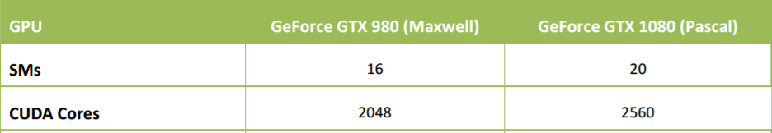
Simultaneous Thread Processing of a GPU
G80 16 SMs , max 768 threads/SM
768x16= 12,288 threads in parallel
GT200 30 SM, max 1,024 threads/SM
1,024x30=30,720 threads in parallel
GTX 1080,
the most recent one(2016)

Slide 11
CUDA block and 1-D thread
thread block
t0
threadIdx.x=0
t5
threadIdx.x=5
t1
t2
t3
t4
The thread index is represented by the given variable ‘threadIdx’.
kernel function:
__global__ void kernel<<<1,6>>>(int a, int b, int c);

Slide 12
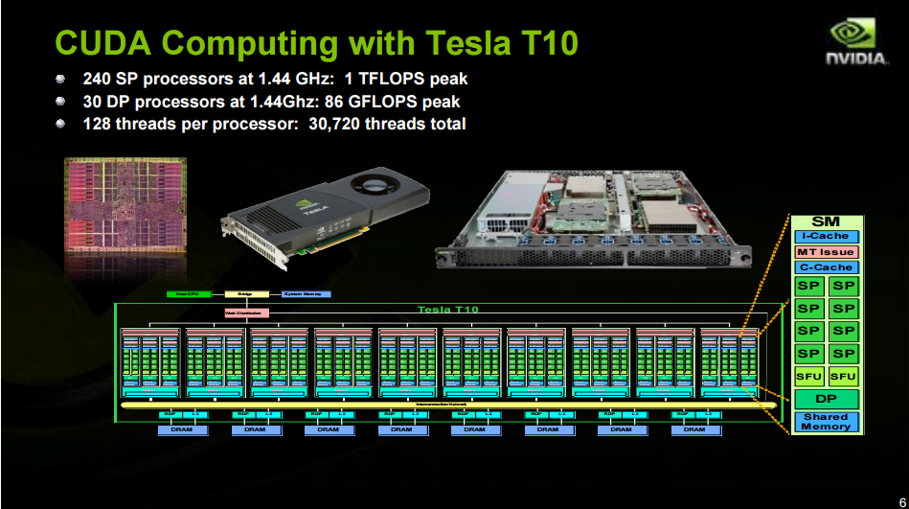
Thread-SP, Block-SM
………
DP: Double Precision Thread Processor
thread block

Slide 13
__global__ void kernel<<<1,512>>>(int a, int b, int c);
thread0: threadIdx.x=0
thread1: threadIdx.x=1
….
thread511: threadIdx.x=511
G80: 16 SM

Slide 14
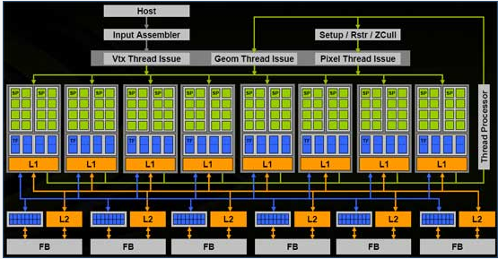
__global__ void kernel<<<1,512>>>( )
Only one SM will be utilized and 15 SMs will be idle.
To utilize all SMs,
__global__ void kernel<<<16,32>>>( );

Slide 15
threadIdx and blockIdx
threadIdx.x, threadIdx.y, threadIdx.z
blockIdx.x, blockIdx.y, blockIdx.z

Slide 16
kernel<<<16,32>>> thread_indexing
block0 : threadIdx.x=0,…….,threadIdx.x=31
block1 : threadIdx.x=0,…….,threadIdx.x=31
…
block15: threadIdx.x=0,…….,threadIdx.x=31
int tid=blockIdx*blocDim.x + threadIdx.x;

Slide 17
GT200: 30 SMs,
16SMs are active and 14 SMs are idle.

Slide 18
Vector Sum
0 | 1 | 2 | 3 | . | . | .
+
0 | 1 | 2 | 3 | . | . | .
=
0 | 2 | 4 | 6 | . | .

Slide 19
Vector Sum
#include <cuda.h>
#include <cuda_runtime.h>
#include <stdio.h>
__global__ void VectorAdd( int*a, int*b, int*c)
{
int tid = blockIdx.x * blockDim.x+ threadIdx.x;
c[tid] = a[tid] + b[tid];
}
int main()
{
const int size = 512*65535;
const int BufferSize = size*sizeof(int);
int* A;
int* B;
int* Sum;
//Allocation of the Host memory
A = (int*)malloc(BufferSize);
B = (int*)malloc(BufferSize);
Sum = (int*)malloc(BufferSize);
int i = 0;
//Data input
for( int i = 0; i < size; i++)
{
A[i] = i;
B[i] = i;
Sum[i] = 0;
}

Slide 20
//Device to Host
cudaMemcpy(Result, d_Sum, size*sizeof(int), cudaMemcpyDeviceToHost);
//Print out the result
for( i = 0; i < 5; i++){
printf(" Result[%d] : %d\n",i,Sum[i]);}
printf(" ......\n");
for( i = size-5; i < size; i++){
printf(" Result[%d] : %d\n",i,Sum[i]);}
cudaFree(d_A);
cudaFree(d_B);
cudaFree(d_Sum);
free(A);
free(B);
free(Sum);
return 0;
}
int* d_A; (gpu memory convention)
int* d_B;
int* d_Sum;
//Allocation of the Device memory
cudaMalloc((void**)&d_A, size*sizeof(int));
cudaMalloc((void**)&d_B, size*sizeof(int));
cudaMalloc((void**)&d_Sum, size*sizeof(int));
//Data transfer from the Host to the Device
cudaMemcpy(d_A, A, size*sizeof(int), cudaMemcpyHostToDevice);
cudaMemcpy(d_B, B, size*sizeof(int), cudaMemcpyHostToDevice);
//Add
VectorAdd<<<65535,512>>>(d_A, d_B, d_Sum);

Slide 21
__global__ void add()
__global__ void VectorAdd( int*a, int*b, int*c)
{
int tid = blockIdx.x * blockDim.x+ threadIdx.x;
c[tid] = a[tid] + b[tid];
}

Slide 22
Thread-Block Dimension
blockDim: block dimension measured in threads.
A block is organized as a 3D array of threads.
gridDim: grid dimension measured in blocks.
Usually a grid is organized as a 2D array of blocks.
Any component left unspecified is initialized to 1
Host side : block.x block.y block.z grid.x grid.y grid.z
Device side : blockDim.x blockDim.y blockDim.z gridDim.x gridDim.y gridDim.z
Decide the block size
Calculate the grid dimension based on the application data size and the block size

Slide 23
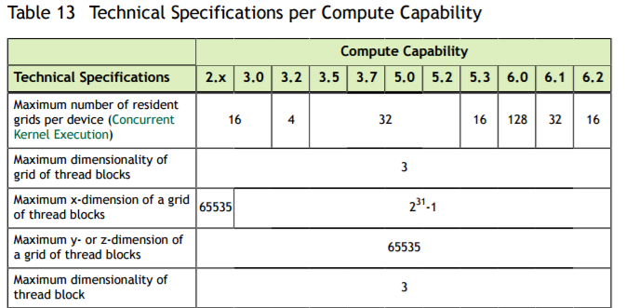
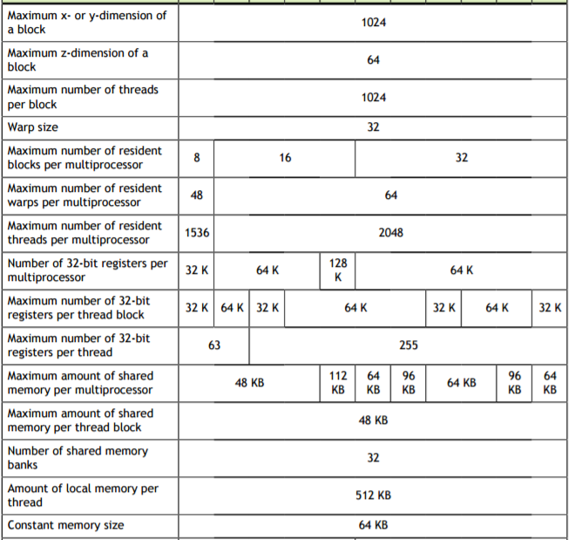

Slide 24
CUDA Thread-block-grid
1 block can have max. 1024 threads.
SM executes threads in a multiple of 32 threads.
__global__ void kernel<<<Dg,Db,Ns,S>>>();
Dg : dimension of the grid , type dim3.
Db : dimension of the block, type dim3.
Ns : number of bytes of shared memory which are dynamically allocated/block, type size_t.
S: Associated cudaStream_t. ‘S=0 ‘ means synchronous.

Slide 25
thread-block dimensions
dim3 Dg(3,2,1);//(x,y,z) grid dimensions
dim3 Db(4,2,1);//(x,y,z) block dimensions
kernelFunction <<<Dg, Db>>> (a,b,c);
Grid
Block

Slide 26
thread indexing
 |  |  |  |  |  |  |  | (tx,ty)
dim3 Dg(3,4,1);
dim3 Db(4,3,1);
int tid, tx,ty;
tx=blockDim.x*blockIdx.x + threadIdx.x;
ty=blockDim.y*blockIdx.y +
threadIdx.y;
tid=NX*ty+tx;
just think of the multidimensional array
int array [Ny][Nx] => IdxY*Nx + Nx
block
NY
NX

Slide 27
Matrix Multiplication, PxQ=R
R(tx,ty)=P(0,ty)xQ(tx,0) + ... + P(11,ty)xQ(tx,11);
Q
ty
P
ty
txty
R

Slide 28
Matrix Multiplication in C
void MatrixMulC( int*M, int*N, int*P, int Width)
{
int col = 0;
int raw = 0;
int index = 0;
int Destindex = 0;
for( col = 0; col < Width; col++)
{
for( raw = 0; raw < Width; raw++)
{
Destindex = col*Width+raw;
for( index = 0; index < Width; index++)
{
P[Destindex] += M[col*Width+index]*N[index*Width+raw];}}}}

Slide 29
Matrix Multiplication
int Value = 0;
int MVal = 0;
int NVal = 0;
for (int i = 0; i < Width; i++)
{
MVal = M[ty * Width + i];
NVal = N[i * Width + tx];
Value += MVal * NVal;
}
P[tid] = Value;
}
#include <cuda.h>
#include <cuda_runtime.h>
#include <stdio.h>
__global__ void MatrixMul( int*M, int*N, int*P, int Width)
{
int tid, tx, ty;
tx = blockDim.x*blockIdx.x + threadIdx.x;
ty = blockDim.y*blockIdx.y + threadIdx.y;
tid = Width*ty + tx;

Slide 30
Sample Program
I
II
III
int main()
{
const int MatrixWidth = 12;
const int MatrixHeight = 12;
const int MatrixSize = MatrixWidth*MatrixHeight;
const int BufferSize = MatrixSize*sizeof(int);
int* M;
int* N;
int* P_cuda;
int* P_C;
//Host memory allocation
M = (int*)malloc(BufferSize);
N = (int*)malloc(BufferSize);
P_cuda = (int*)malloc(BufferSize);
P_C = (int*)malloc(BufferSize);
int i = 0;
//Data input
for( int i = 0; i < MatrixSize; i++)
{
M[i] = i;
N[i] = i;
P_cuda[i] = 0;
P_C[i] = 0;
}
cudaFree(dev_M);
cudaFree(dev_N);
cudaFree(dev_P);
free(M);
free(N);
free(P_cuda);
free(P_C);
return 0;
}
int* dev_M;
int* dev_N;
int* dev_P;
//Device memory allocation
cudaMalloc((void**)&dev_M, BufferSize);
cudaMalloc((void**)&dev_N, BufferSize);
cudaMalloc((void**)&dev_P, BufferSize);
//Host to device
cudaMemcpy(dev_M, M, BufferSize, cudaMemcpyHostToDevice);
cudaMemcpy(dev_N, N, BufferSize, cudaMemcpyHostToDevice);
dim3 Dg(3, 4, 1);
dim3 Db(4, 3, 1);
//Addition
MatrixMul<<<Dg,Db>>>(dev_M, dev_N, dev_P, 12);
//Device to Host
cudaMemcpy(P_cuda, dev_P, BufferSize, cudaMemcpyDeviceToHost);
MatrixMulC(M, N, P_C, 12);
bool ResultFlag = true;
//Print the result
for( i = 0; i < MatrixSize; i++)
{
//printf(" Result[%d] : %d, %d\n",i,P_cuda[i],P_C[i]);
if( P_cuda[i]!= P_C[i]) ResultFlag = false;
}
if( ResultFlag == true) printf(" MatrixMul Result OK!\n");
else printf(" MatrixMul Result Error!\n");

Slide 31
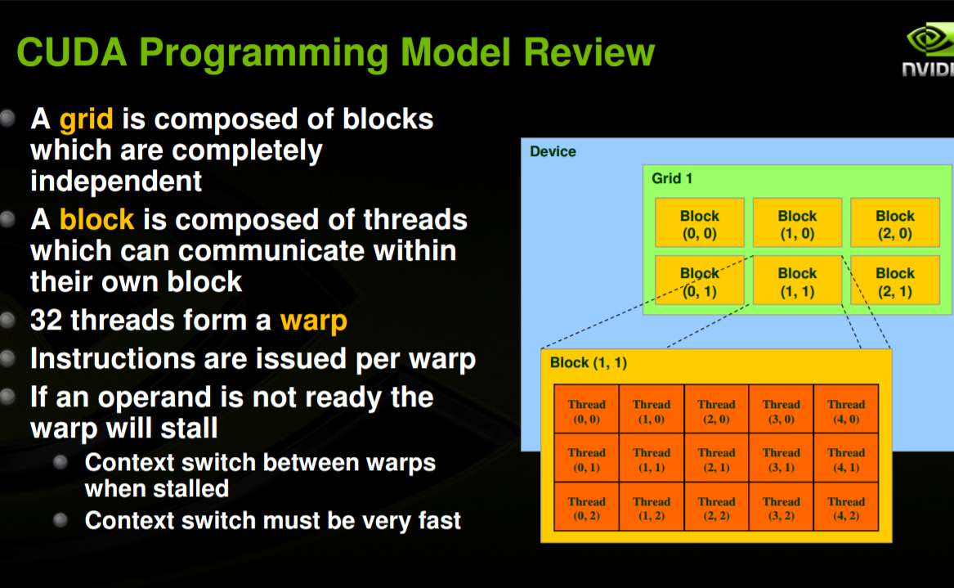
Warp

Slide 32
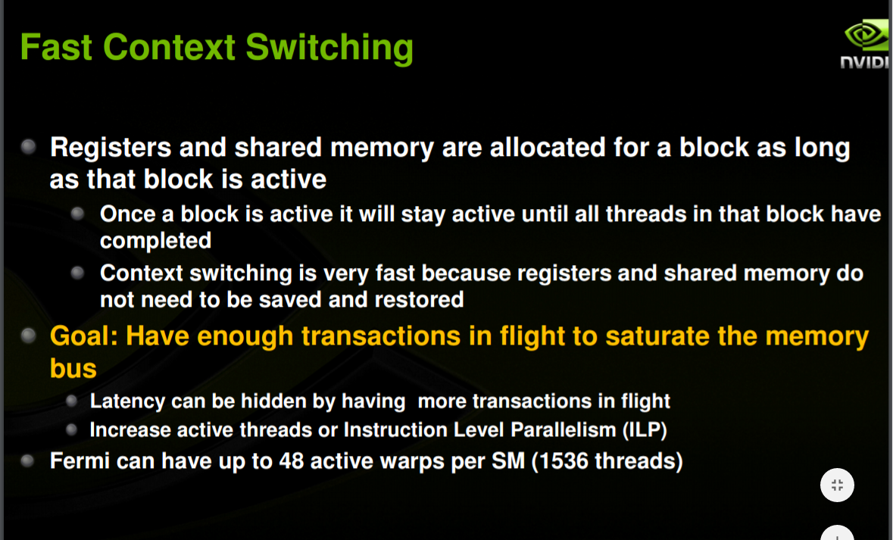
Fast Context Switching

Slide 33
Host
Device
One grid execution at a time on a device.
Different kernels may have different grid structures.
Kernel
function0
Grid 0
Block
Block
스레드
스레드
Block
Block
CUDA
Execution
Flow
스레드
스레드
Kernel
function1
Grid 1
Block
스레드
Block
스레드
Block
스레드

Slide 34
Handling Errors
#define ERROR(function)
{
const cudaError_t error = function;
if( error !=cudaSuccess)
{
printf(“Error:%s, %d” , __FILE__,__LINE__);
printf(“code:%d, reason: %s\n”,error,cudaGetErrorsString(error));
exit(1);
}
}
Example:ERROR(cudaMemcpy(A, …….));

Slide 35
Execution Time Check
CPU Timer
#include <sys/time.h>
Use ‘gettimeofday( )’ system call.

Slide 36
Timing with nvprof
$nvprof ./hello
Time
107.23us…..
time for CPU,
time for cudaMemcpy
time for GPU…

Slide 37
Organizing Parallel Threads
Matrix Addition:
2D Grid with 2D Blocks
1D Grid with 1D Blocks
2D Grid with 1D Blocks

Slide 38
Indexing Matrices with Blocks and Threads
An 8x6 matrix is stored linearly in global memory with a row-major approach.
(0,0)…
8x6 Matrix
nx=8
…(7,5)
row0 |  |  |  |  | row5
ny=6

Slide 39
2D Grid -2D Blocks
ix=threadIdx.x + blockIdx.x*blockDim.x
iy=threadIdx.y + bloxkIdx.y*blockDim.y
(ix,iy)
Global linear memory index, idx=iy*nx+ix

Slide 40
Matrix with a 2D Grid and 2D Blocks
nx
0 | 1 | 2 | 3 | 4 | 5 | 6 | 7
8 |  |  |  |  |  |  | 15
16 |  |  |  |  |  |  | 23
24 |  |  |  |  |  |  | 31
32 |  |  |  |  |  |  | 39
40 |  |  |  |  |  |  | 47
row 0
Block(0,0)
Block(1,0)
ny
Block(0,1)
Block(1,1)
Block(0,2)
Block(1,2)
row 5
col 0
col 4

Slide 41
Matrix with a 1D Grid and 1D Blocks
nx
Block 0 | Block 1 | Block 2 | Block 3
ny
idx=iy*nx + ix

Slide 42
Matrix with a 2D Grid and 1D Blocks
Block(0,0) | Block(1,0) | Block(2,0) | Block(3,0)
Block(0,1)
Block(0,ny) | Block(1,ny) | Block(2,ny) | Block(3,ny)
idx=iy*nx + ix

Slide 43
Homework#1
Due: Mar. 13, 2017
To: Joo Kyung Ro, PhD Student(eu8198@kaist.ac.kr)
Page Limit of your report: max. 5pages excluding your source code and the screen captured result.

Slide 44
hello.cu
#include <stdio.h>
__global__ void funct(void) {
printf(“Hello from GPU!\n”);
}
int main(void){
funct<<<1,4>>>( );
printf(“Hello, World from CPU!\n”);
cudaDeviceReset();
return 0;
}

Slide 45
Problem 1
(1) Remove cudaDeviceReset() from the hello.cu and run it. Show the result and explain it.
(2) Replace cudaDeviceReset() in hello.cu with cudaDeviceSynchronize(). Run it and explain the result.
cudaDeviceSynchronize - A kernel call is asynchronous with respect to the host thread. After a kernel is invoked, control returns to the host side immediately. You can call the following function to force the host application to wait for all kernels to complete

Slide 46
Problem 2- Addition of Matrices
At the page 19,20 of this lecture note, there is a sample program of vectors addition. Refer to the vector addition, make your program that add two matrices on 2D grid and 2D blocks where:
int nx=16384;
int ny=16384;
int dimx=32;
int dimy=32;
dim3 block(dimx,dimy); //block dimension (32,32)
dim3 grid((nx + block.x-1)/block.x, (ny+block.y-1)/block.y);
//grid dimension (512,512)
Generate the matrix A and B treating them as linear array as follows:
//Data input
for( int i = 0; i < size; i++)
{
A[i] = i;
B[i] = i;
Sum[i] = 0;
}

Slide 47
Problem 2 continued
Run your program and measure the execution time using the Linux system call ‘gettimeofday()’.
Change the block configuration to
a. (32, 8), b. (32, 16), c. (32, 64),
d. (64, 8), e. (64, 16), f. (64, 32).
Compare and explain the execution time
of each case.

Slide 48
Major Research Area of Students
Machine Learning and Its architectures:
강상훈,서준,Mario,김훈, 김혜지, 한승렬, Romain, 정휘영
1D,2D,3D Signal Processing
김용신,김영석,박진우,기세환,김태경
Parallel Processing
배소윤,오은영,정재호,김재엽,유찬희
Others
이준희(SMS),박상욱(Security)

Slide 49
Presentation Schedule
1.Mar. 16: 김태경
Matrix Multiplication with CUDA, Robert Hochberg, 2012.
2.Mar. 16: Romain Renard
Deep Learning Tutorial, Pater Sadowski,2015
or You may prepare the presentation material by yourself or
select some other material on the deep learning subject.

